Slide 1

SOFTWARE ENGINEERING
Week 9
Software Design Engineering I

Slide 2
Agenda
Unified Modeling Language
Software Design Concepts
Structured Design

Slide 3

Unified Modeling Language
Unified Modeling Language
Software Design Concepts
Structured Design
Object Oriented Design Principles
User Interface Design
Case Study: SafeHome

Slide 4
What is UML?
Unified Modeling Language (UML) is the standard tool for visualizing, specifying, constructing, and documenting the artifacts of an object-oriented software.
UML is not a programming language, but only a visual design notation.
Can be used with all software development process models.
Independent of implementation language.
Many CASE tools uses UML for automatic code generation. Examples: IBM Rational, ArgoUML, etc.
You may be familiar with some UML concepts introduced in Object Oriented Programming course.

Slide 5
Background
UML is the result of an effort to simplify and consolidate the large number of Object Oriented development methods and notations.
Developed by the Object Management Group based on work from:
Grady Booch [91]
James Rumbaugh [91]
Ivar Jacobson [92]
The latest version is UML 2.5 (See http://www.omg.org or http://www.uml.org)

Slide 6
Types of UML Diagrams
•Use Case Diagrams (*)
•Class Diagrams (*)
• Interaction Diagrams
Sequence Diagrams (*)
Collaboration Diagrams
• State Transition Diagrams
• Activity Diagrams
• Implementation Diagrams
Component Diagrams
Deployment Diagrams

Slide 7
Minimal UML Process
Partially articulated
requirements
Capture
requirements
Use Case Diagram
Requirements
Construct
model of
system
Class Diagram
Structure
Sequence Diagram
Behaviour

Slide 8
Views of UML Diagrams
Structural View
Class Diagram
Implementation View
Component Diagram
User View
Use Case Diagram
Behavioral View
Collaboration Diagram
Activity Diagram
State Diagram
Environment View
Deployment Diagram

Slide 9
Use Cases
Use case diagrams are used to visualize, specify, construct, and document the (intended) behavior of the system, during requirements capture and analysis.
Provide a way for developers, domain experts and end-users to Communicate.
Serve as basis for testing.

Slide 10
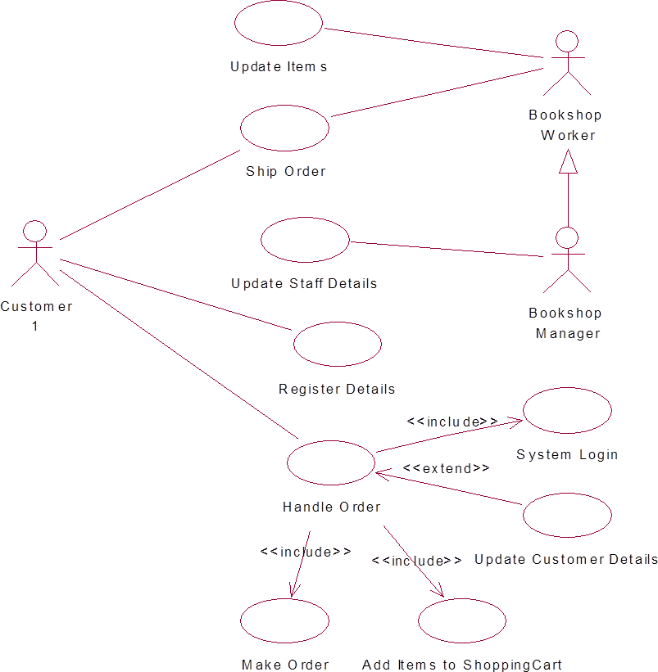
Example : Use Case Diagram

Slide 11
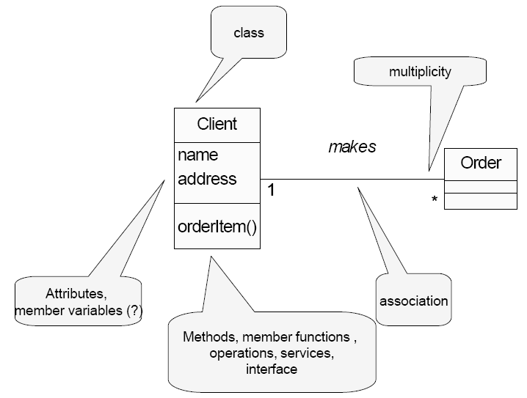
Class Diagrams

Slide 12
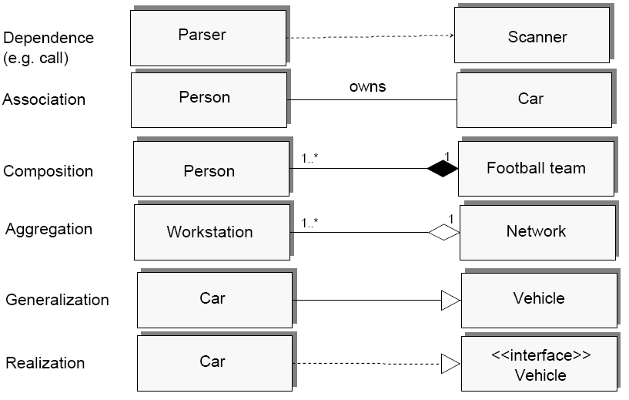
Class Relations
Notes:
In composition – when parent class is removed, the child is destroyed.
In aggregation, child class is part of another class. The child class instance can outlive its parent class.
Basic association can also be represented as another class in between the two classes.
Generalization (super class on the tip of triangle) e.g. BankAccount is general class, CheckAccount and SavingAccount are two subclasses
Realization , interface is only implemented/realized by the other class.

Slide 13
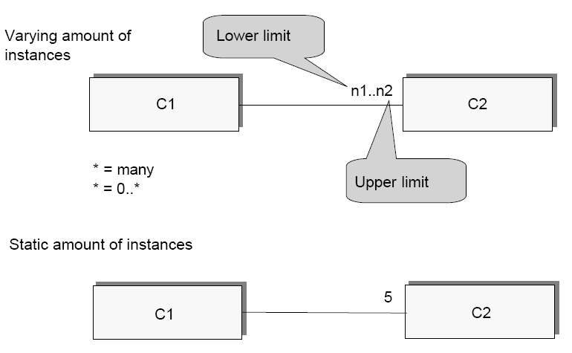
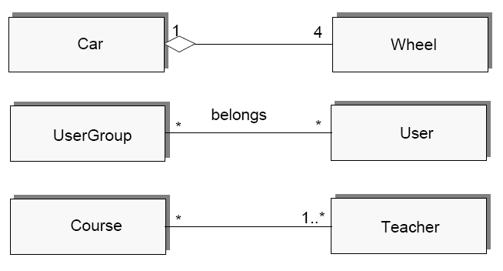
Cardinality

Slide 14
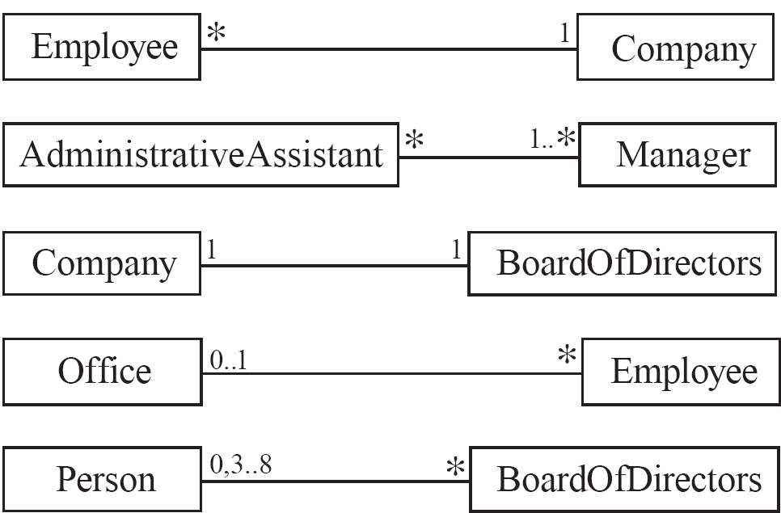
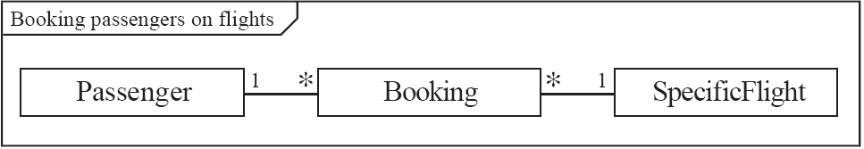
Class relations (examples)

Slide 15
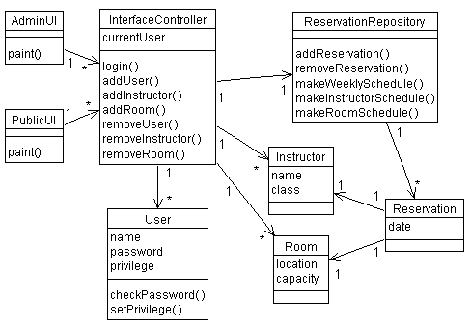
Example : Class Diagram
A classroom scheduling system: specification perspective.

Slide 16
Example : From Class Diagram to Code
Notes:
Associations are by default bi-directional. It is possible to limit the direction of an association by adding an arrow at one end.

Slide 17
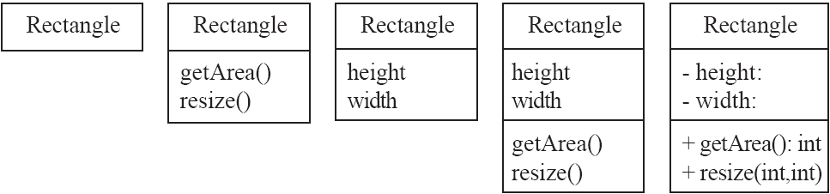
Class diagrams
A class is simply represented as a box with the name of the class inside
The diagram may also show the attributes and operations
The complete signature of an operation is:
operationName(parameterName: parameterType …): returnType
Notice the character in front of the variables and functions
Plus (+) denotes public
Minus (-) denotes private
Hash (#) denotes protected

Slide 18
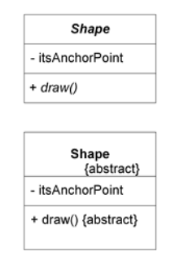
Class diagrams
public class Rectangle {
private int height;
private int width;
public int getArea() { … }
public void resize(int x, int y) { … }
}
public abstract class Shape {
private Point itsAnchorPoint;
public abstract void draw();
}

Slide 19
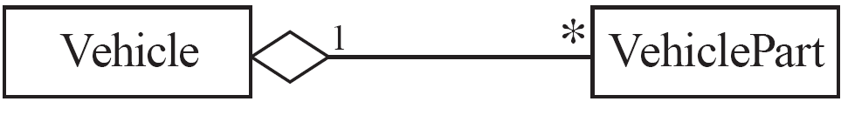
Propagation
public class Vehicle{
private Collection <VehiclePart> part;
public int getWeight(){
int weight = 0;
for(Iterator<VehiclePart> it = part.iterator(); it.hasNext(); ){
weight += (it.next()).getWeight();
}
return weight;
}
}
private Vehicle vehicle;
public class VehiclePart{
private int weight;
public int getWeight(){
return weight;
}
}

Slide 20
A detailed example for Genealogy problem
Problem: Imagine you are developing a genealogy system, in which you have to keep track of
) unions (e.g., marriages and partnerships)
) parent-child relationships

Slide 21
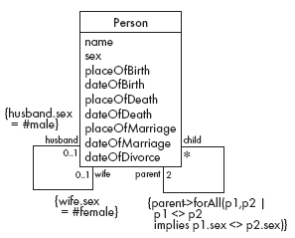
Detailed Example: A Class Diagram for Genealogy
v
v
Problems?

Slide 22
Detailed Example: A Class Diagram for Genealogy
Problems
Marriages not properly accounted for, i.e., a person may have multiple marriages
Marriage information (e.g., placeOfMarriage) is duplicated
A person must have two parents

Slide 23
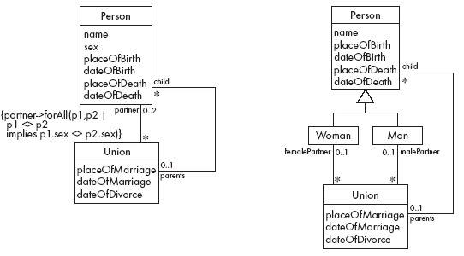
Genealogy example: Possible solutions

Slide 24
Genealogy example: Possible solutions

Slide 25
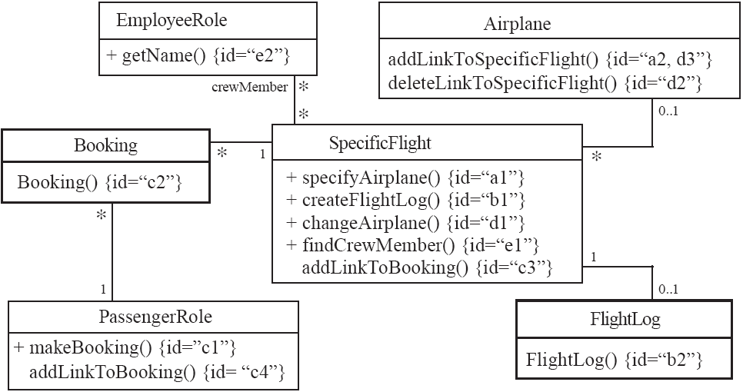
Class collaboration
Notes:
Example for associations (a). SpecificFlight instance makes a link to Airplane (private field), and calls its operation a2, the instance of Airplane keeps a list of SpecificFlight and adds one to the list.

Slide 26
Interaction Diagrams
UML presents two types of interaction diagrams.
Sequence Diagrams
Collaboration Diagrams

Slide 27
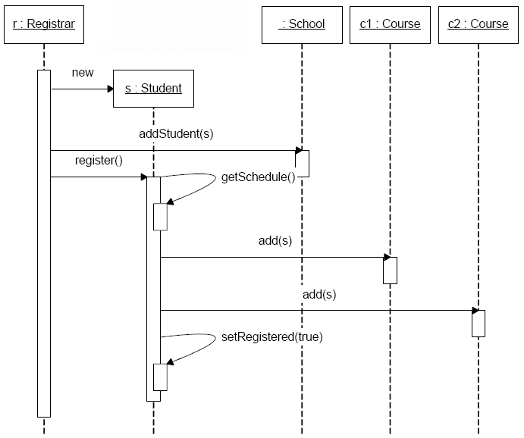
Sequence Diagrams

Slide 28
Example : Mapping Diagram to Code
Mapping sequence diagram to Java code

Slide 29
Collaboration Diagrams

Slide 30
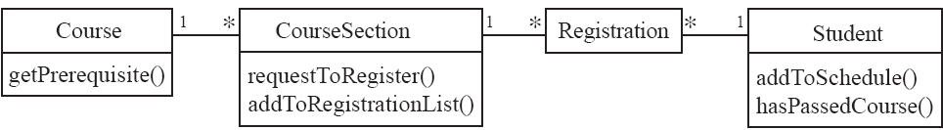
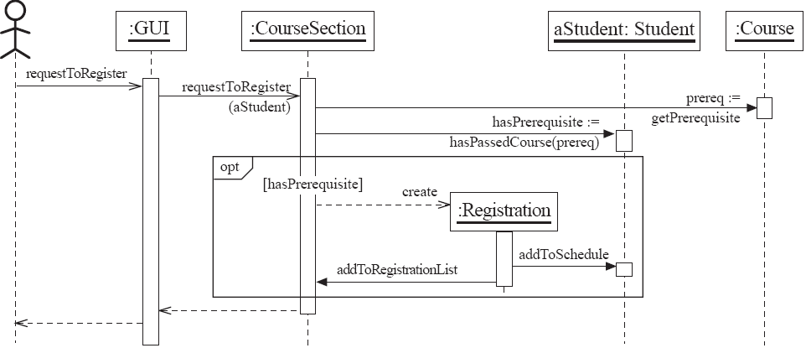
Conditional cases

Slide 31
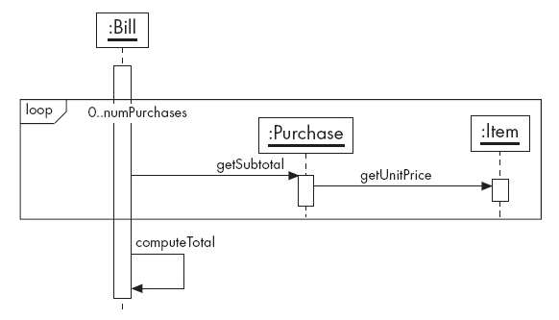
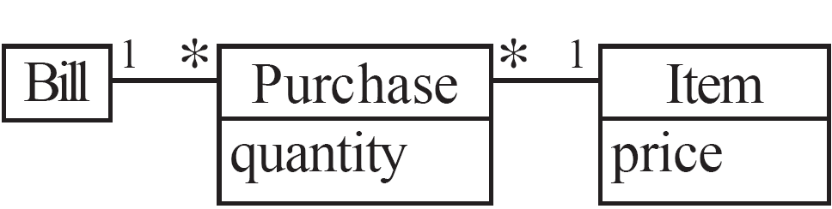
Loop conditions

Slide 32
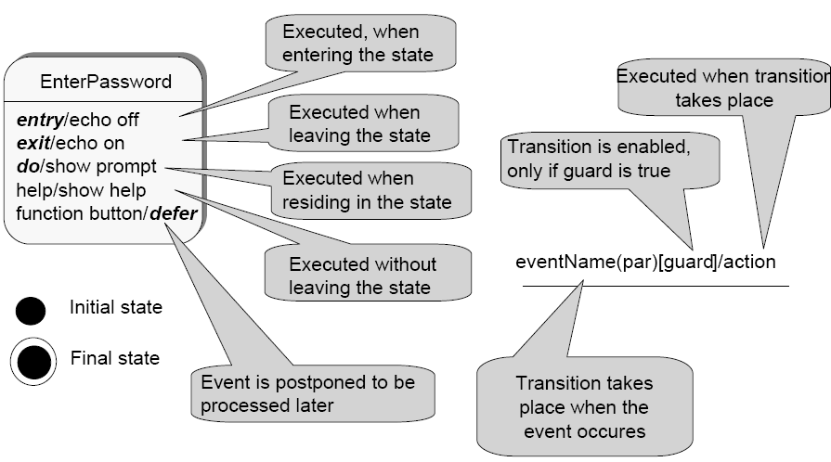
Behavioral models: State Chart Notation
State transition diagram shows
The events that cause a transition from one state to another
The actions that result from a state change

Slide 33
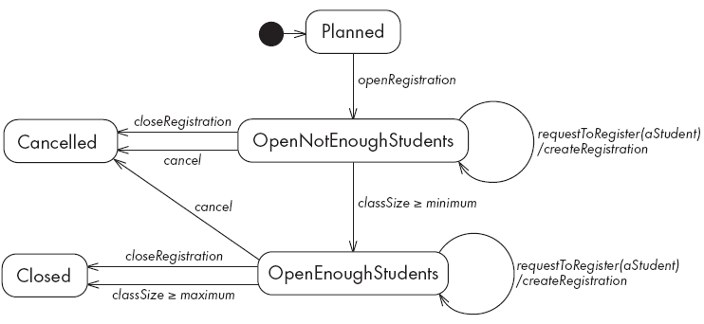
State diagram of CourseSection Class

Slide 34
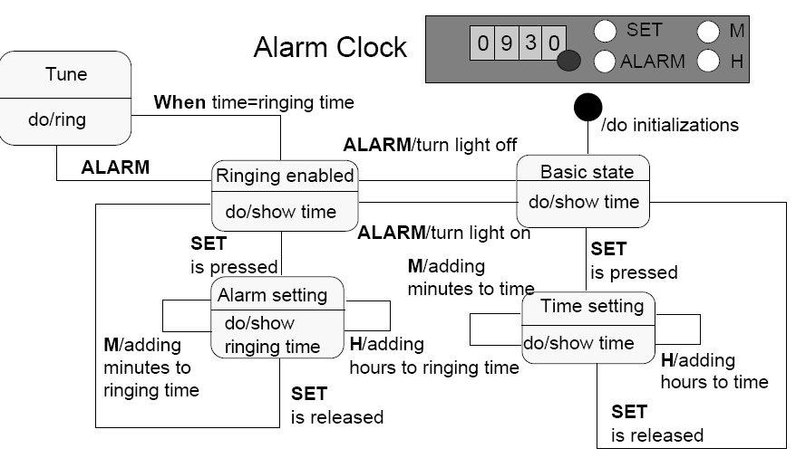
Example : State Chart Diagram

Slide 35

Package Diagrams
Component diagrams illustrate the organizations and dependencies among software components in physical world.
A component may be
A source code component
A run time components
An executable component
People.dll
Course.dll
User
Course
Student
Teacher
Course
Course
Section

Slide 36
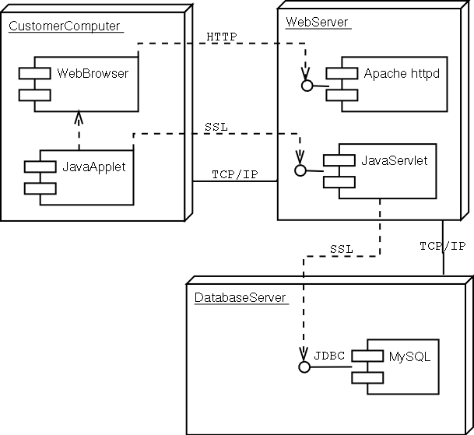
Deployment Diagrams
Captures the distinct number of computers involved
Shows the communication modes employed
Component diagrams can be embedded into deployment diagrams effectively

Slide 37
Analysis Model → Design Model
37

Slide 38
Software Design Concepts
Unified Modeling Language
Software Design Concepts
Structured Design
Object Oriented Design Principles
User Interface Design
Case Study: SafeHome

Slide 39
Design Concepts (1)
Component:
Any piece of software or hardware that has a clear role.
A component can be isolated, allowing you to replace it with a different component that has equivalent functionality.
Many components are designed to be reusable.
Conversely, others perform special-purpose functions.
Module:
A component that is defined at the programming language level.
For example, functions are modules in C.
For example, methods, classes and packages are modules in Java.
39
Notes:
39

Slide 40
Design Concepts (2)
Modularity:
A complex system may be divided into simpler pieces called modules.
A system that is composed of modules is called modular.
When dealing with a module we can ignore details of other modules.
Use divide and conquer method for modularity.
For two modules m1 and m2, the effort relation is as follows: E(m1) + E(m2) < E(m1+m2)
40

Slide 41
Design Concepts (3)
Abstraction:
Abstraction is a means of achieving stepwise refinement by suppressing unnecessary details.
It is to conceptualize problem at a higher level.
Abstractions allow you to understand and concentrate on the essence of a subsystem without having to know unnecessary details.
The designer should keep the level of abstraction as high as possible.
Data abstraction (Abstract Data Type):
A data type together with the operations performed on instantiations of that data type.
Procedural abstraction:
The designer defines a procedure at a higher level.
41

Slide 42
Example: C definition without Data Abstraction
struct personel
{
long int TCNum;
char Ad[20], Soyad[20];
int DTarihi_gun, DTarihi_ay, DTarihi_yil;
int IGTarihi_gun, IGTarihi_ay, IGTarihi_yil;
} ;
42

Slide 43
Example: C definition with Data Abstraction
typedef struct
{
int gun, ay, yil;
} tarih;
struct personel
{
long int TCNum;
char Ad[20], Soyad[20];
tarih DogumTarihi; //abstraction
tarih IseGirisTarihi; //abstraction
} ;
43

Slide 44
Example:C program without Procedural Abstraction
#include <stdio.h>
#include <stdlib.h>
#define N 5
int main()
{
int a[N] = {10,20,30,40,50};
int b[N] = {15,25,35,45,55};
int i;
for (i=0; i < N; i++) printf("%d \t", a[i]);
printf("\n");
for (i=0; i < N; i++) printf("%d \t", b[i]);
return 0;
}
44

Slide 45
Example:C program with Procedural Abstraction
#include <stdio.h>
#include <stdlib.h>
#define N 5
void yaz(int dizi[], int M) {
int i;
for (i=0; i < M; i++)
printf("%d \t", dizi[i]);
printf("\n");
}
int main() {
int a[N] = {10,20,30,40,50};
int b[N] = {15,25,35,45,55};
yaz(a, N); //abstraction
yaz(b, N); //abstraction
return 0;
}
45

Slide 46
Layers of Software Design
Architectural Design
Modular Design
Data Design
Transforms the information domain model created during the analysis into the data structures, file structures, database structures that will be required to implement software.
Data objects and relationships in ERD and the detailed data content depicted in the data dictionary provide the basis.
Behavioral Design
Transforms structural elements of the program architecture into a procedural description of software components.
Information obtained from PDL (Algorithms / Flowcharts) serve as basis.
User Interface Design
46

Slide 47
Structured Design Approach
Unified Modeling Language
Software Design Concepts
Structured Design
Object Oriented Design Principles
User Interface Design
Case Study: SafeHome

Slide 48
Data-Oriented Design
Basic principle
The structure of a product must conform to the structure of its data
Three very similar methods
Michael Jackson [1975], Warnier [1976], Orr [1981]
Data-oriented design
Has never been as popular as action-oriented design
With the rise of OOD, data-oriented design has largely fallen out of fashion

Slide 49
Operation-Oriented Design
Data flow analysis
Use it with most specification methods (Structured Systems Analysis here)
Key point: We have detailed action information from the DFD
Figure 14.1

Slide 50
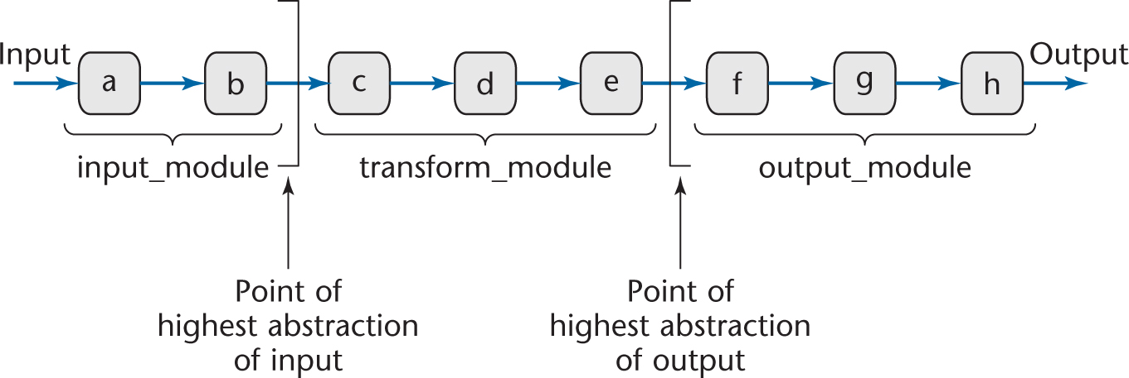
Data Flow Analysis
Every product transforms input into output
Determine
“Point of highest abstraction of input”
“Point of highest abstract of output”
Figure 14.2

Slide 51
Data Flow Analysis (contd)
Decompose the product into three modules
Repeat stepwise until each module has high cohesion
Minor modifications may be needed to lower the coupling

Slide 52
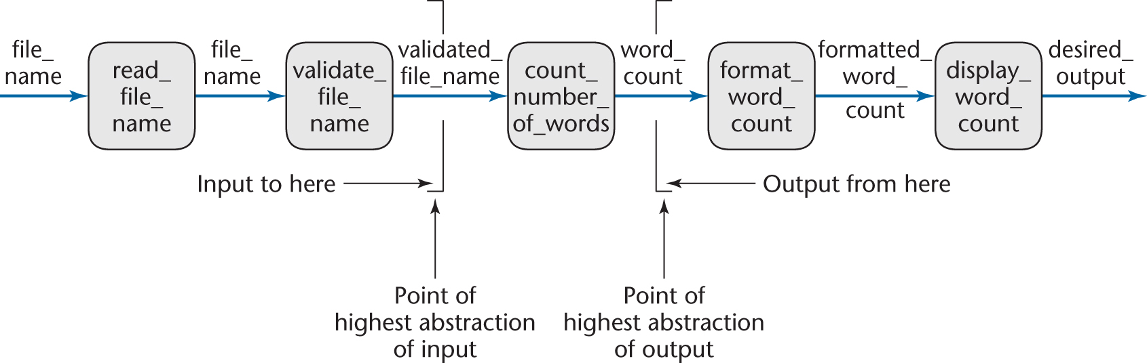
Mini Case Study: Word Counting
Example:
Design a product which takes as input a file name, and returns the number of words in that file (like UNIX wc )
Figure 14.3

Slide 53
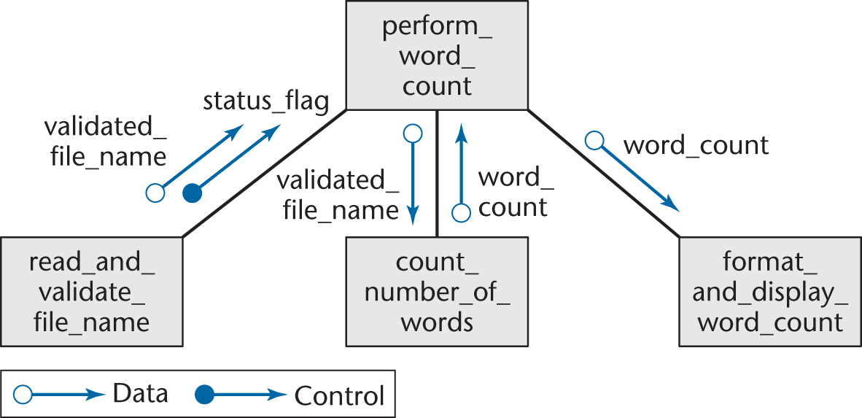
Mini Case Study: Word Counting
First refinement
Now refine the two modules of communicational cohesion
Figure 14.4

Slide 54
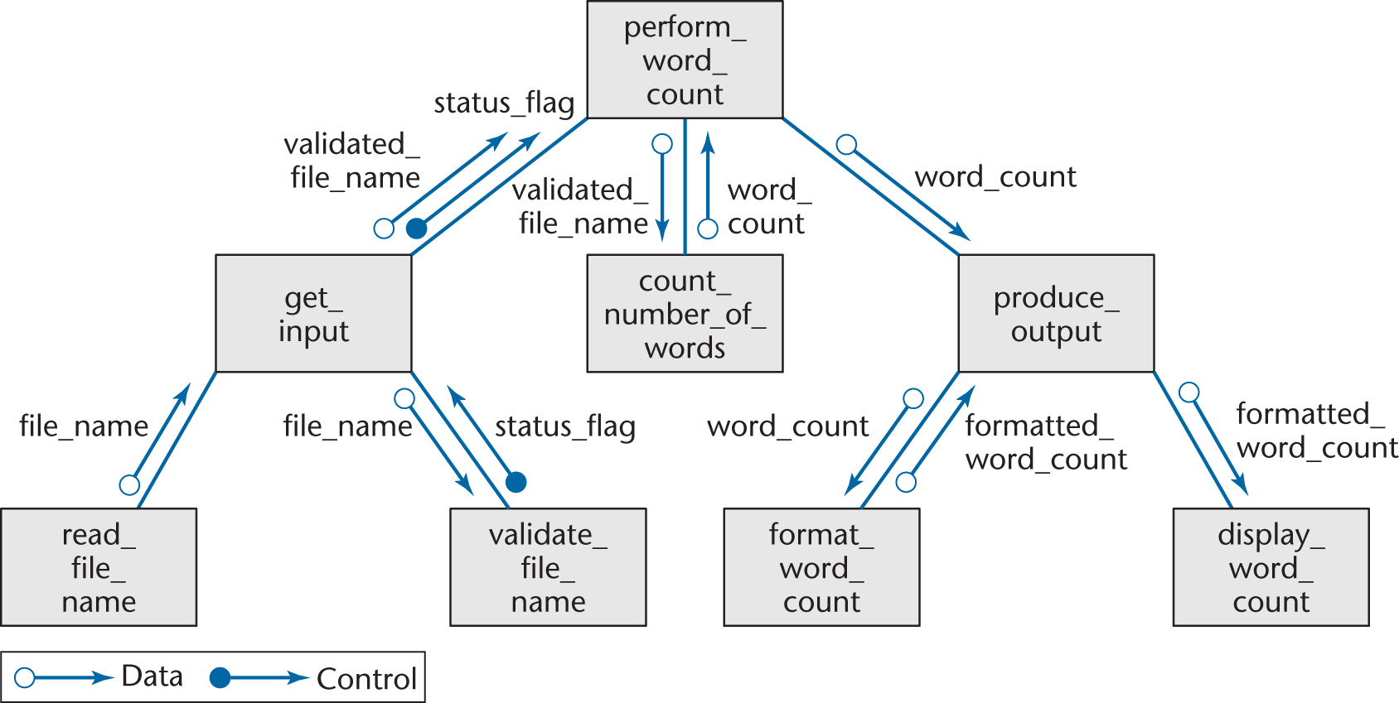
Mini Case Study: Word Counting
Second refinement
All eight modules now have functional cohesion
Figure 14.5

Slide 55
Word Counting: Detailed Design
The architectural design is complete
So proceed to the detailed design
Two formats for representing the detailed design:
Tabular
Pseudocode (PDL — program design language)

Slide 56
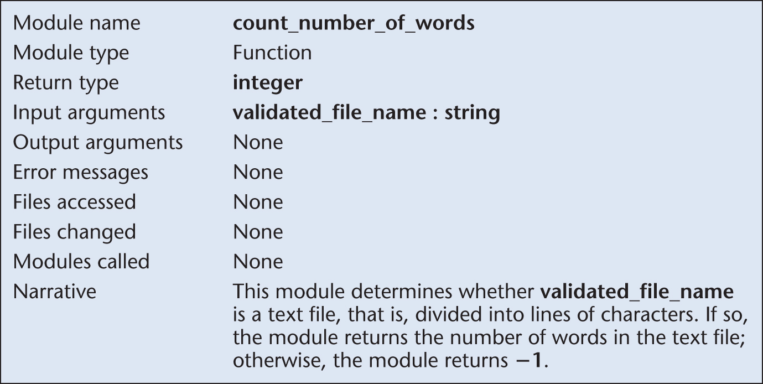
Detailed Design: Tabular Format
Figure 14.6(c)

Slide 57
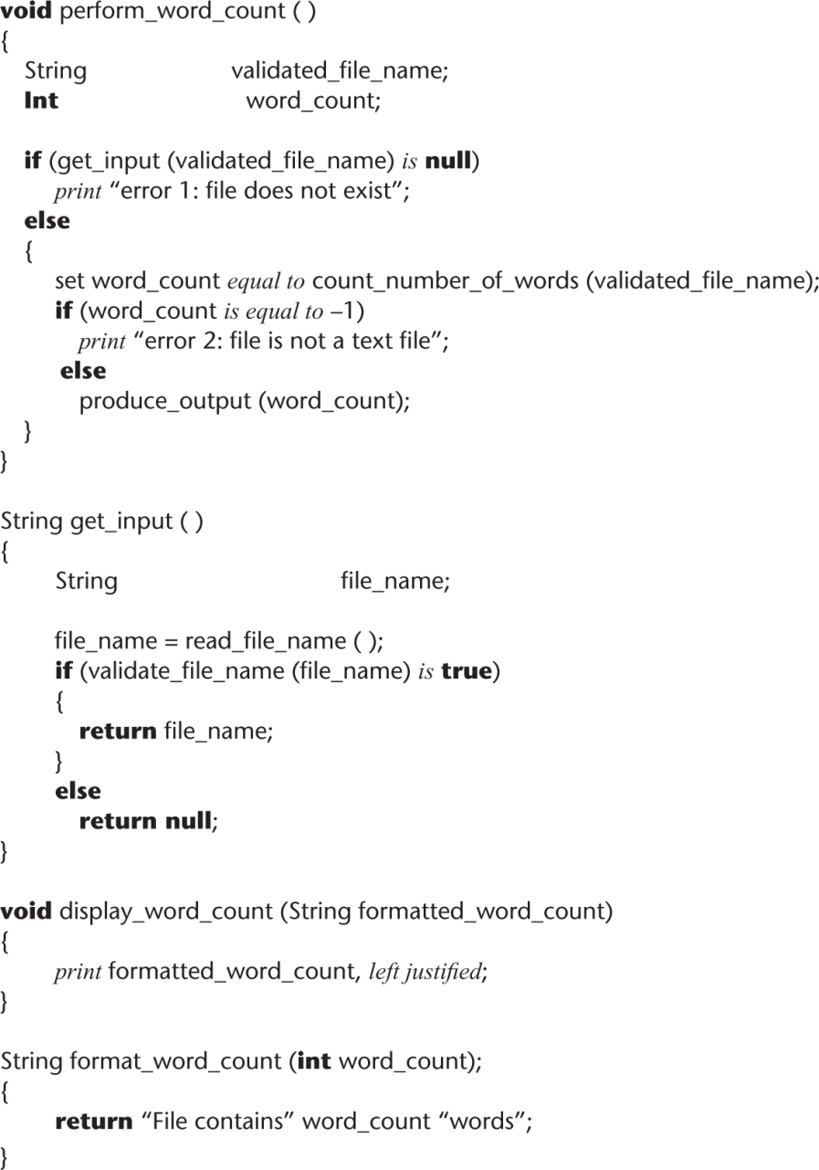
Detailed Design: PDL Format
Figure 14.7

Slide 58
Data Flow Analysis Extensions
In real-world products, there is
More than one input stream, and
More than one output stream

Slide 59
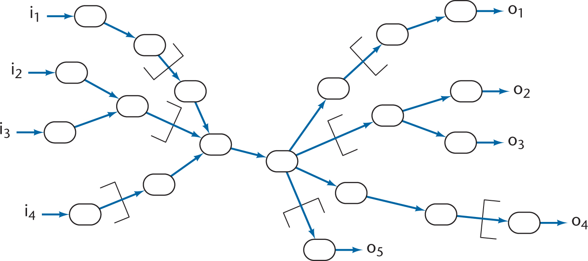
Data Flow Analysis Extensions
Find the point of highest abstraction for each stream
Continue until each module Works on a single responsibility
Figure 14.8

